Slide 1


Exploration Managers Conference
London 2023
Vaughan Chamberlain
Amira Global Africa Chair

Slide 2
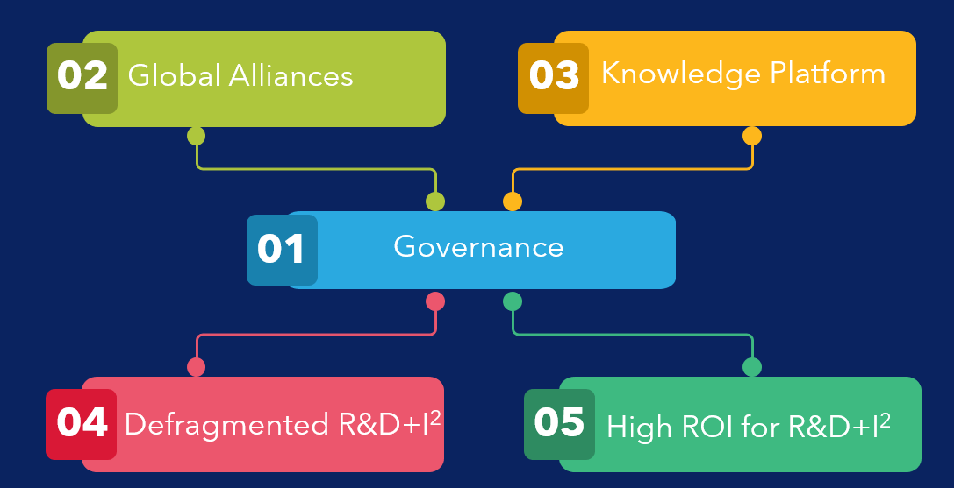
Core Strategy

Slide 3
Governance Platform
Trusted platform to manage collaborative sponsorship across jurisdictions
Delivery to scope on budget and on time
Transparent, Independent, Consistent, Audited

Slide 4
Global Alliances
Building trusting and trusted relationships across the ecosystem to accelerate pathways for deployment of R&D
Connections, Efficiencies, Shared Access

Slide 5

Collaborative Platform
Create a platform to aggregate R&D outcomes
that are trusted, verified, impactful ... and efficient to access
Knowledge, Innovation, Impact

Slide 6
Defragment R&D+I2
Develop cohesive and integrated programs of work
that bring best value to industry
at the highest efficiencies
Systems of Systems Approach to Industry Investment in R&D

Slide 7
Focus on Impact for Industry
Amira model enables leverage of R&D investment
...typically between 1:15 and 1:20
Focus on delivering highest return of investment to sponsors

Slide 8
Connectons, Efficiencies, Shared Access

Slide 9
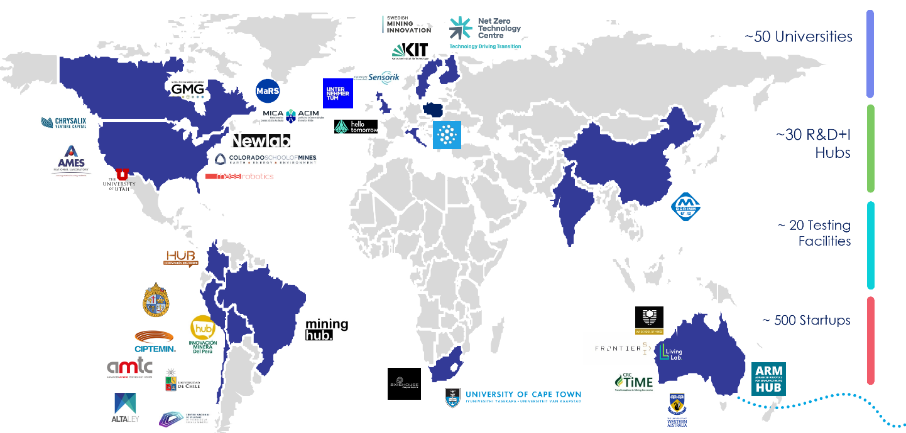
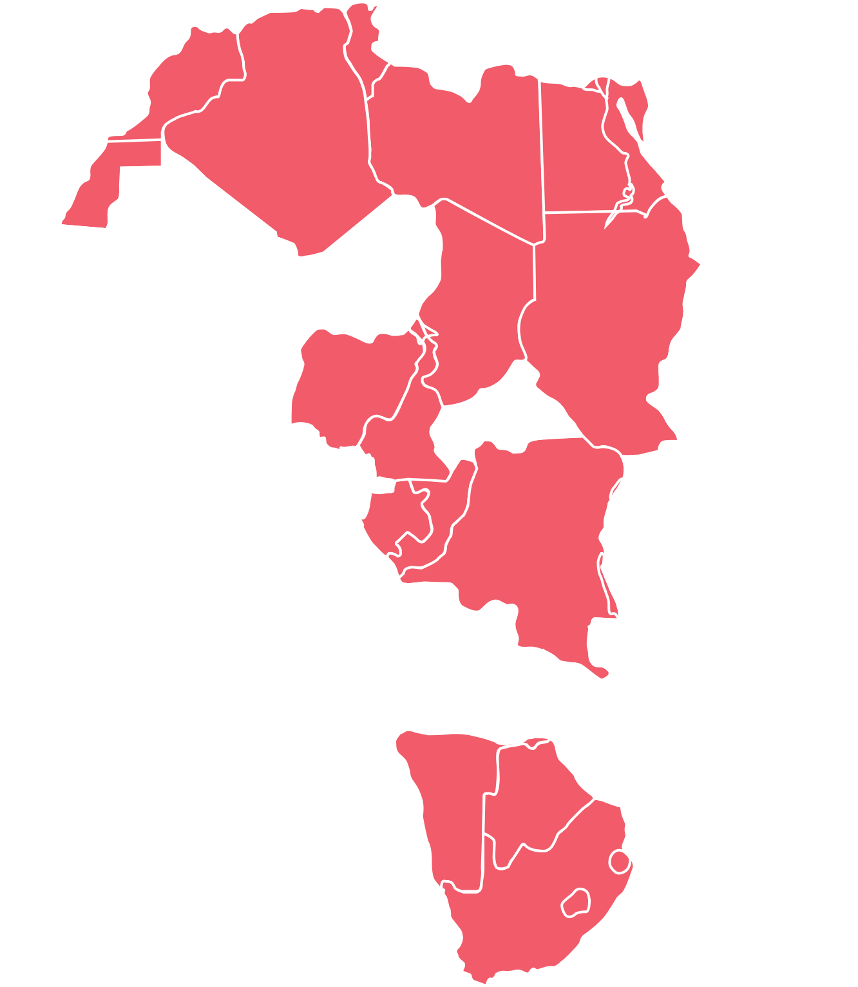
The Amira Global Alliance is a network of organisations around the world formed to benefit Amira Global Members and our industry.

Slide 10
Knowledge, Innovation, Impact

Slide 11

Vision:
A central, openly accessible platform that provides a trusted synthesis of evidence-based research and information to inform the minerals industry ecosystem
Purpose:
To ensure research knowledge is preserved, centralised and is made accessible for industry practitioners, researchers, and government agencies.
Success:
Accelerated research and innovation uptake and informed industry decision making and planning globally.
Access to One Central Trusted and Verified Source of R&D Outcomes

Slide 12


Phase 1
MVP
Phase 2
Phase 3
Phase 4
SCALING:
Knowledge
Year 2
Year 3-7
Year 7+
SCALING:
Collaboration
SCALING:
Innovation
SCALING:
Impact
  Design and implement a governance system to secure a sustainable business model
  Outreach and partnerships to inform Phase 2 and longer-term plan including host entity
  Develop, design and secure partnerships, including funding for Phase 2 and beyond
  Augment Stakeholder Programs
  Deploy analytics for pattern ﬁnding & trends
  Extend content from global partners
  Deliver R&D insights to members and sponsors
  Deliver insights to Government and Research partners
  Communicate captured value and technology opportunities
  Create, collaborate, and deploy match-making functionality to increase technology integration with market objectives
  Identify R&D gaps and discover researchers in the landscape
  Monitor R&D trends to inform targeted investment
  Use systems based design and analytics to inform research programs
  Amplify R&D outcomes by identifying innovative research collaborations
  Accelerate R&D landscape against market focus areas
  Self-sustaining, continual renewal and adaptation to market challenges and forces
  Reconcile industry translation of R&D outcomes;
  Evaluate success characteristics and incorporate into future R&D+I2 design for deployment
Built in personalisation features to increase relevance

Slide 13
Systems of Systems Approach to Industry Investment in R&D

Slide 14

Pan-African Decarbonisation Institute
A virtual Institute that connects world class research capability with the needs of the African industry to build knowledge, and develop processes and decarbonization applications using Africa's resources.

Slide 15

Value Proposition
The Pan-African Decarbonization (P-ADI) Institute will provide​ a platform for Africa to participate meaningfully in the​ decarbonization value chain.
It will contribute industry focused​ research to the development of the whole value chain,​ transforming energy systems and sectors globally, and ensure​ economic return is maximized for Africa's new energy​ resources.
Science, Engineering & Technology
Research, Leadership & Capability development
Leadership & Community
Government Policy
Economics & Business
Mineral Discovery
Mining & Processing
Extracting & Refining
Product Manufacturing
Integration & Delivery
Recycling

Slide 16
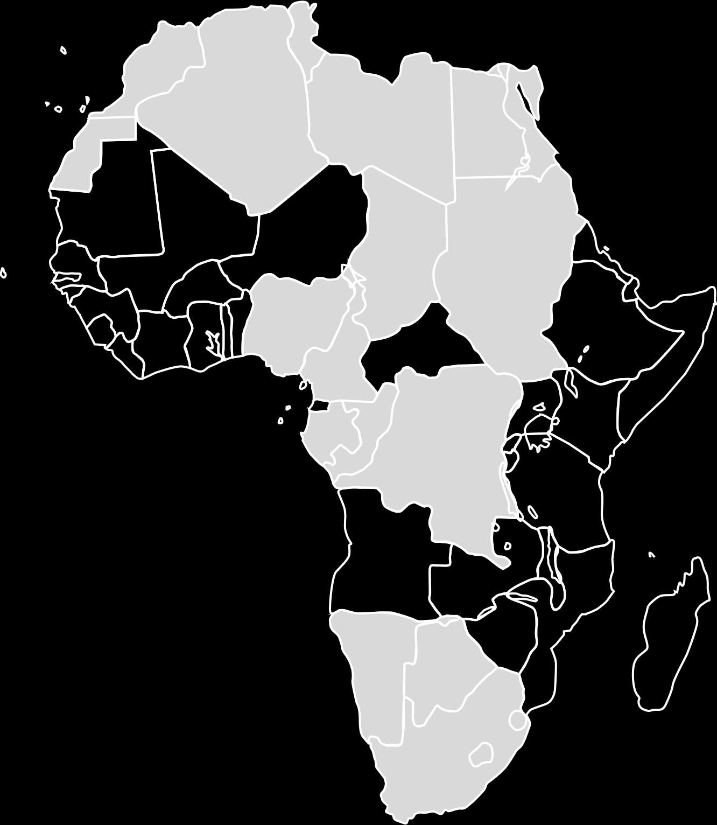
Pan-African Decarbonization Institute (P-ADI)​
Program 1: Decarbonization Minerals Discovery & Extractive Technologies
Explore technology and processes that improve the efficiency of mining resources and the processing to refined products used in decarbonization, including environment, water optimization; Operations skills training and development; Talent and capability building
Program 2: Decarbonizing the Mine
R&D + Innovation to step change mining operations to meet operating companies’ decarbonization targets Operational decarbonization efficiency drives.
01
02
P-ADI
Program 4: Leadership, Policy & Economics
Develop industry and agency leadership to address a coordinated Pan-African approach to minerals and decarbonization policy, economics and industry development and leadership approaches to address Environment, Society, Community and Governance (ESG)
04
03
Program 3: Supply Chain Development & Integration
Explore supply chain optimization, including decarbonized transport routes, regional business development, and Pan-African infrastructure optimization, battery pre-cursor manufacturing

Slide 17
Focus on delivering highest return on investment to sponsors

Slide 18
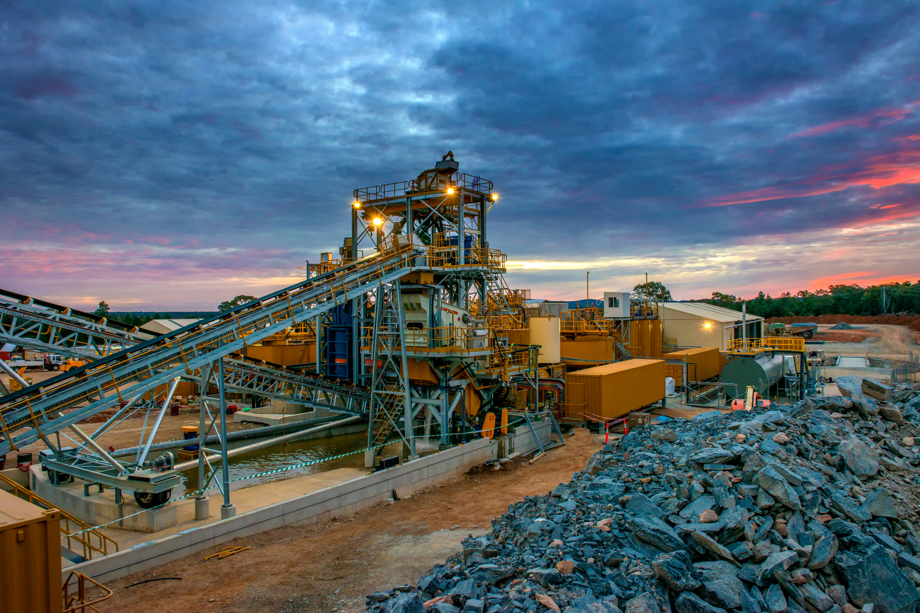





Seeking to partner with mining companies to develop
an applied innovation platform & innovation testbed
Create an engine for technical innovation while future-proofing the infrastructure that will be built out over the next decade
Mobilize advanced technology companies to co-develop solutions and collaborate around place-based pilot projects
Position Mining companies’s physical footprint / strategic infrastructure as a critical applied R&D and innovation asset for the mining industry and drive advanced technology development
Developing a pilot program for Glencore Copper operational excellence team, using their Chilean Operation as a testing facility

Slide 19
Exploration Managers Conference
London 2023

Slide 20
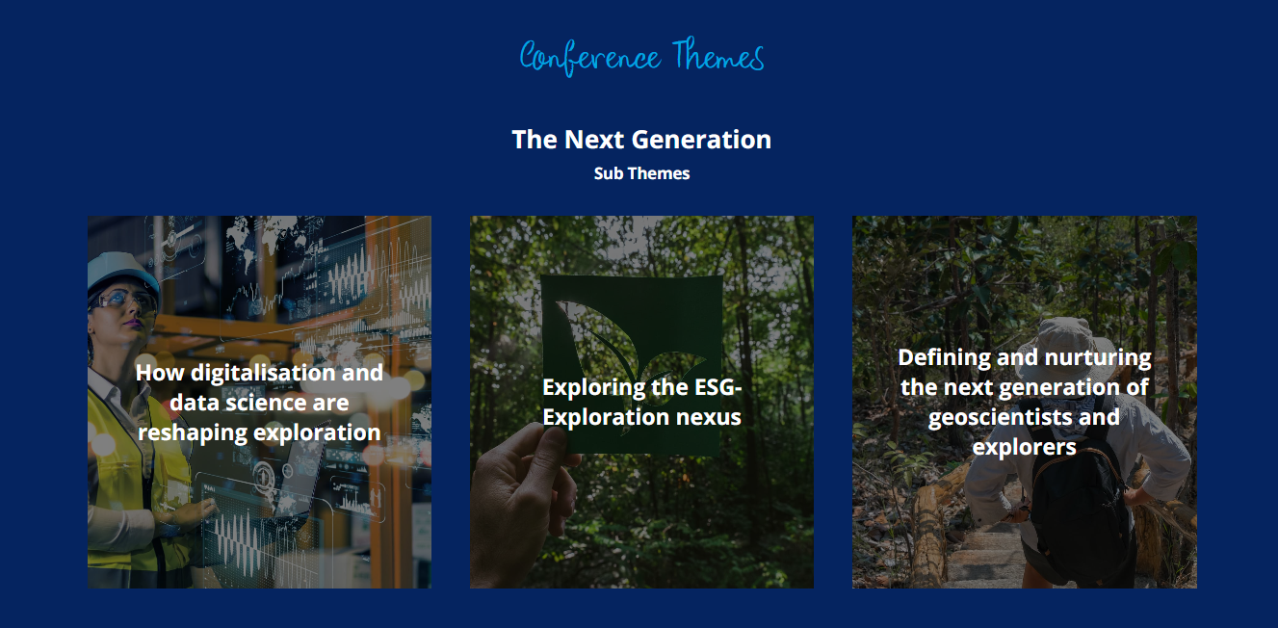

Slide 21
Values & Conduct
Participate!
Disagreeing is OK – but respectfully
If we don’t talk about it we won’t solve it
Let’s confer

Slide 22

